Slide 1


Labyrinth Escape
Jorge Leonardo Quimi Villon
4058221
Presentazione esame
COMPUTER GRAPHICS ARCH. - GAMES AND SIMULATION
xx/xx/2021

Slide 2


Summary
Target…………………………………………………………
Introduction………………………………………………….
MonoGame framework…………………………………….
The structure of Labyrinth Escape………………………
The main classes……………………………………………
The states of the game……………………………………
Handle Save File……………………………………………
Conclusion and future developments………………….

Slide 3
Target and Introduction
Create a game, in this case rework the labyrinth covered during the lessons, using Monogames framework.
The aim of the game is to get the character out of the labyrinth by avoiding obstacles and looking for the key to go to the next level.
make the shortest possible time
The game is divided into several levels, in increasing order of difficulty.

Slide 4
MonoGame Framework
Labyrinth Escape was create using MonoGame, an open-Source framework for cross-platform videogames:
The structure of a game created with MonoGame is essentially based on three classes:
Game: the heart of the videogame which is also the entry point of the program. It contains the interfaces of the essential methods for the game and called by the base class:
Inizialize(): contains the basic initialization of the graphics and input sector;
LoadConten(): upload multimedia content;
Update(): method called before rendering of each frame. It takes as input a GameTime object used to get a lot of information about the game's time status
Draw(): renders all the elements of the game on the screen. As Update(), it takes a GameTime object as argument.

Slide 5
MonoGame Framework
Graphics.SpriteBatch: allows the rendering of all Texture2D objects
Content.ContentManager: allows to manage all the multimedia resources of the game. For this purpose, the framework provides the Content Pipeline tool which, by means of a graphic interface, allows an easier management of the contents.

Slide 6
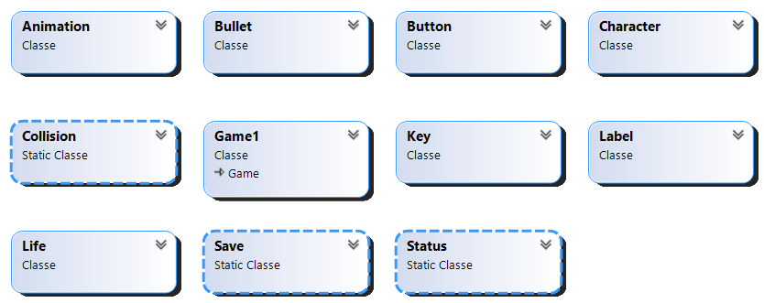
The Structure of Labyrinth Escape

Slide 7
The main classes
Collision: This static class handles collisions with the character. This implements the following methods:
CollisionBullet(): When the character collides with a bullet, he loses a life and starts over from the beginning
CollisionKey(): When the character encounters a key, it is deleted from the labyrinth and increasing the number of keys held
CollisionLife(): When the character encounters a heart, it is deleted from the labyrinth and increasing the number of hearts held.
Save: This class manages a txt file in which the best time is saved in crossing the maze. when the game starts it is loaded and when a single game ends it updates if the time is less.
Character: This class allows to create a character capable of moving in the game and interacting with the obstacles on the map. Each Character object can be manipulated from the keyboard with WASD commands thanks to the method keyboardMgnt.

Slide 8
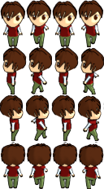
The main classes
Animation: award to each individual sprite an animation given by the succession of frames which are grouped in a single texture. The animation technique is based on showing only a portion of the texture in which the frame you want to view is present.

Slide 9
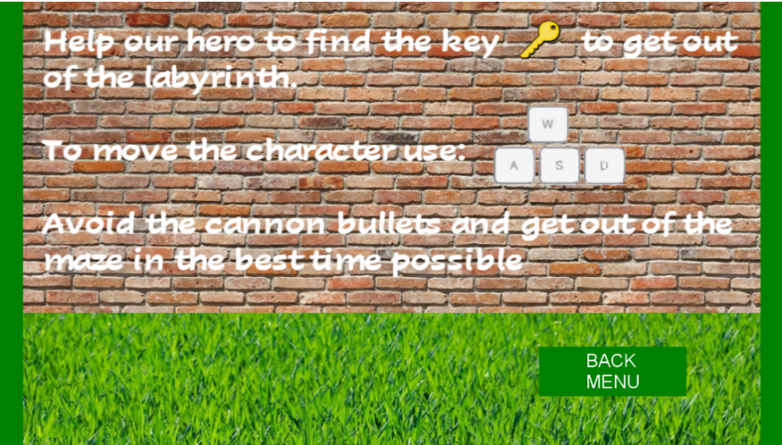
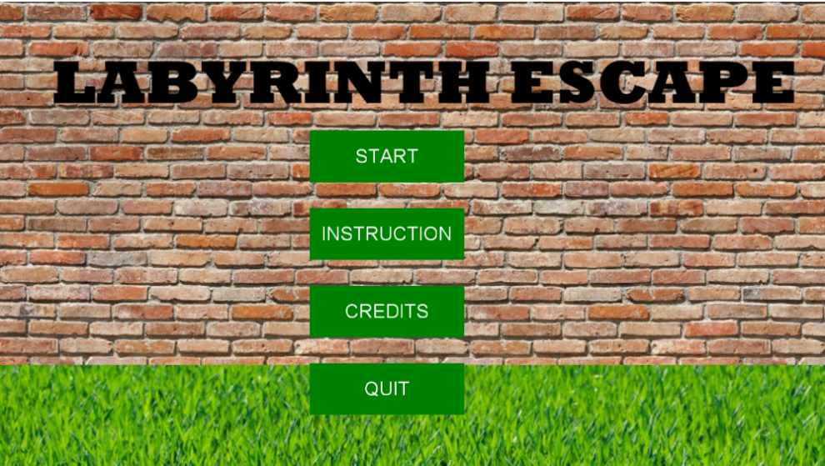
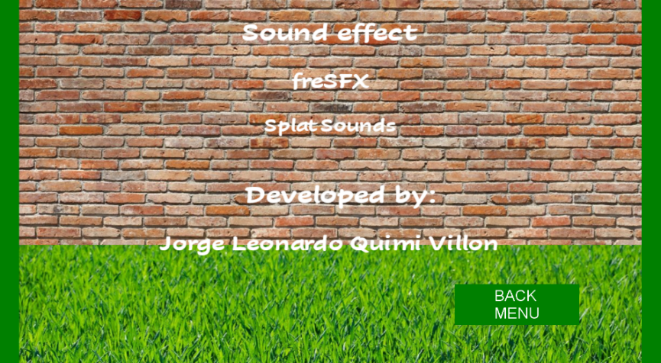
The states of the game

Slide 10
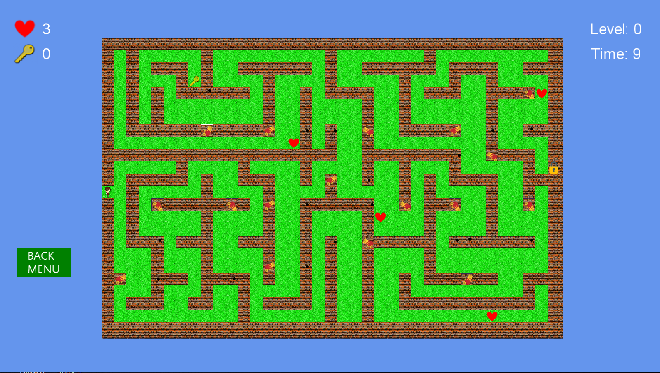
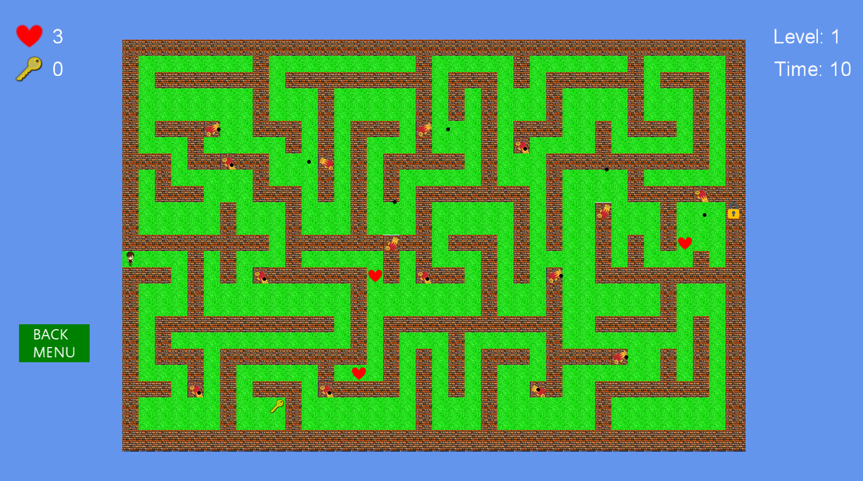
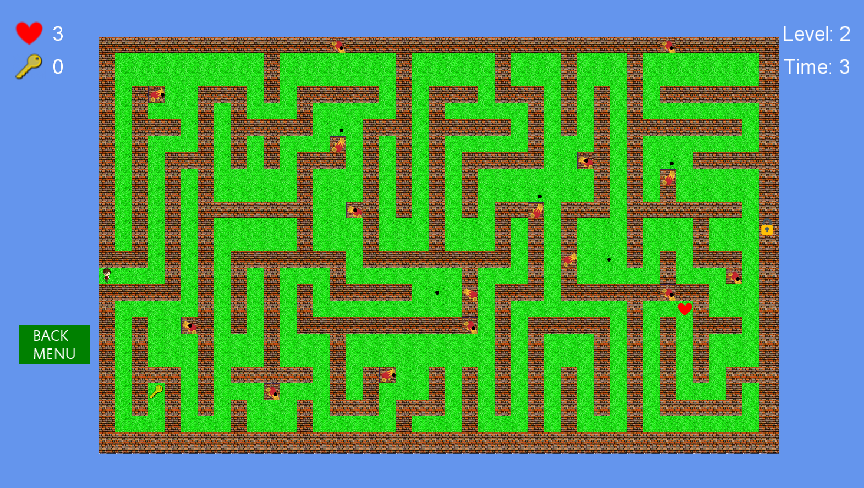
The states of the game
Start

Slide 11
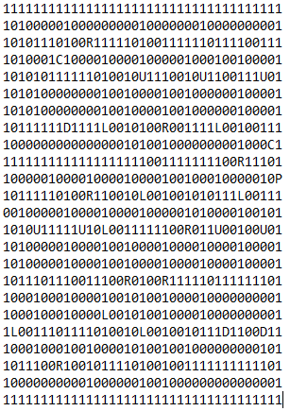
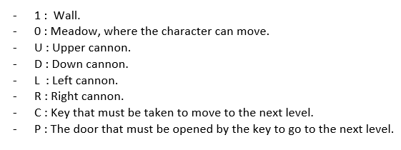
The states of the game
Create a level
.txt file

Slide 12
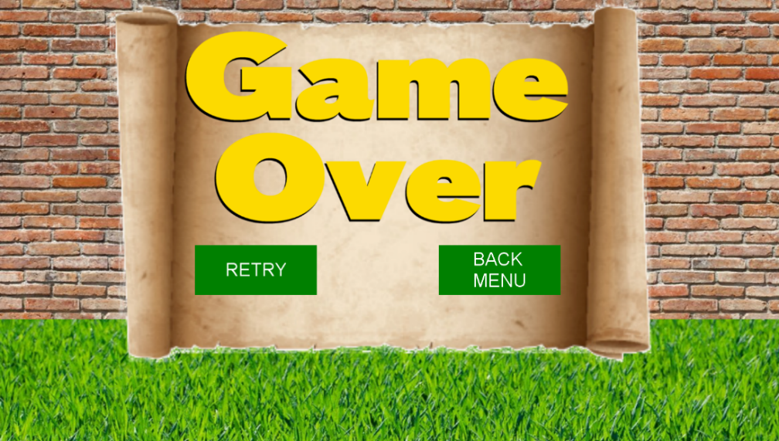
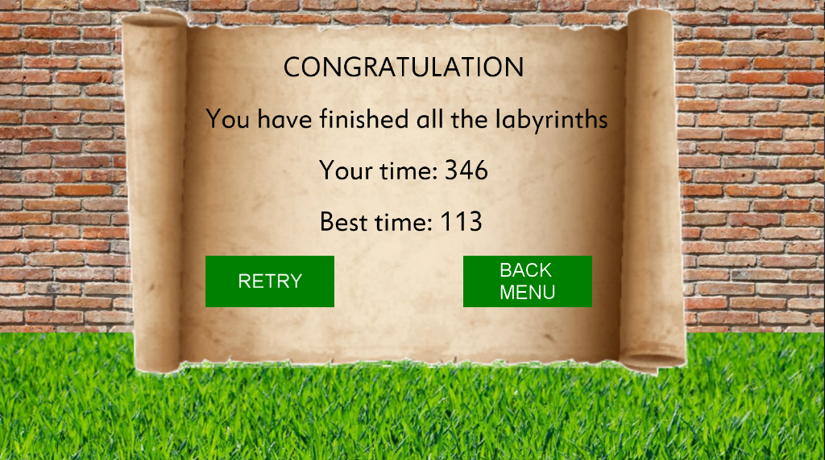
The states of the game
Game Over and Win screen

Slide 13
Video

Slide 14
Conclusion and future developments
The development of this game has been very important for the understanding and practice of creating 2D games using the C# language and Monogame.
A control system was used for the development of this game, Git version control system (VCS). In this case I did a single job, but it is very important if you do teamwork.
Labyrinth escape can still be improved and expanded. I thought it would be interesting to implement a recurse system of game state to recover an interrupted game. Also, in order to broaden the perspective of game, it may be useful to add new maps, and new traps.

